Slide 1
Play Super Mario!
By using reinforcement learning
Name : Tonson Praphabkul
Student ID No: 123010
Name : Todsavad Tangtortan
Student ID No: 123012

Slide 2
Objectives & Goal
Study reinforcement learning by using Deep Q-Network (and Double Deep Q-Network if possible)
At least Mario need to clear one stage.
Extra challenge: Make Mario clear the stage without stop moving.

Slide 3
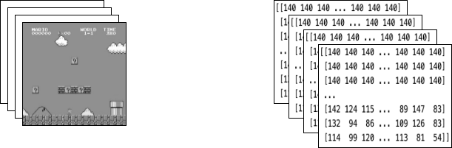
After applying the above wrappers to the environment, the final wrapped state consists of 4 gray-scaled consecutive frames stacked together, as shown above in the image on the left. Each time Mario makes an action, the environment responds with a state of this structure. The structure is represented by a 3-D array of size [4, 84, 84]

Slide 4
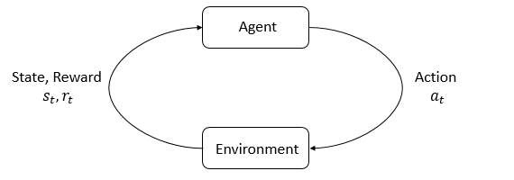
Why Q-learning
Q-Learning is a Reinforcement learning policy that will find the next best action, given a current state. It chooses this action at random and aims to maximize the reward.

Slide 5
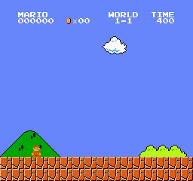
Scope
Model will be trained only first game stage (World 1-1)

Slide 6
References
Engelsvoll, Ruben Nygård; Gammelsrød, Anders; Thoresen, Bjørn-Inge Støtvig, Generating Levels and Playing Super Mario Bros. with Deep Reinforcement Learning
Roclark, “Super mario bros. dqn.” https://github.com/roclark/ super-mario-bros-dqn#Progress.
Liao, Y., Yi, K., & Yang, Z. (n.d.). CS229 Final Report Reinforcement Learning to Play Mario. -. https://cs229.stanford.edu/proj2012/LiaoYiYang-RLtoPlayMario.pdf
Feng, Y., Subramanian, S., Wang, H., & Guo, S. (n.d.). TRAIN A MARIO-PLAYING RL AGENT. Pytorch. Retrieved November 7, 2022, from https://pytorch.org/tutorials/intermediate/mario_rl_tutorial.html

